Slide 1
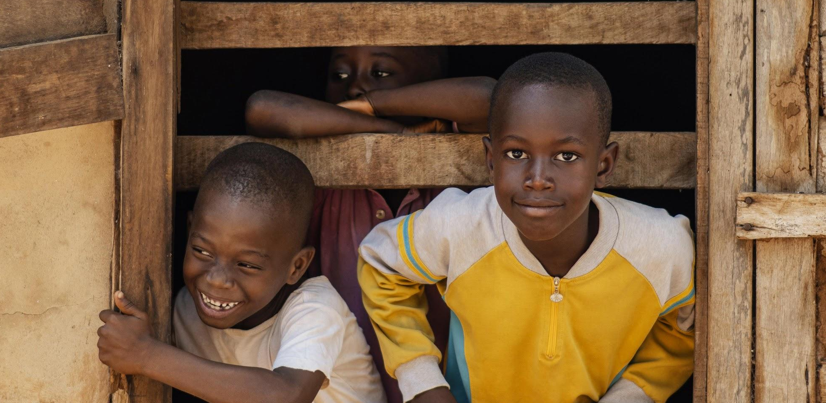
UNITED NATIONS' SUSTAINABLE DEVELOPMENT GOALS

Slide 2
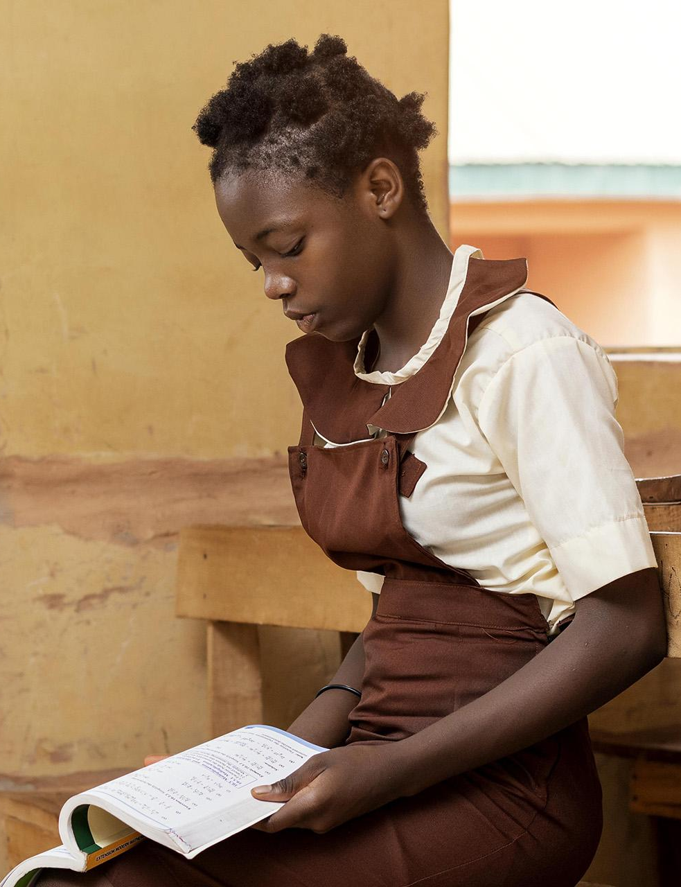
Ending Poverty with Education

Slide 3
What does Poverty mean?
Poverty, in the simplest sense of the word, is a state where one lacks access to basic needs such as food, clothing and shelter.
It is also used to describe a person whose living conditions prevent them from being able to acquire education, seek medical help, secure a stable job, and participate in recreational activities due to a lack of money.

Slide 4
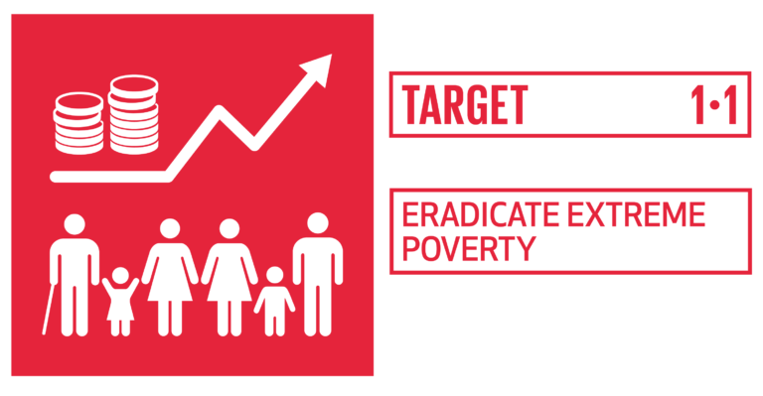
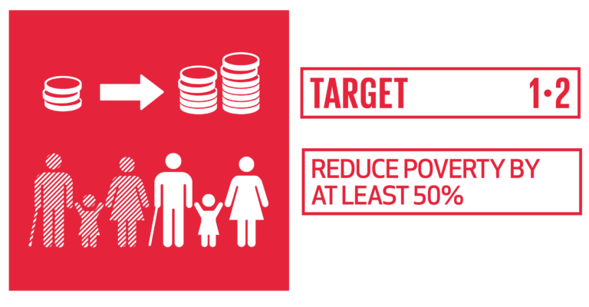
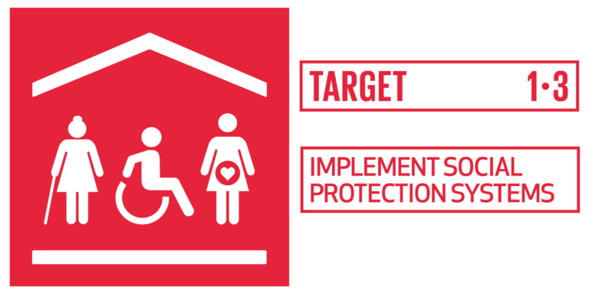
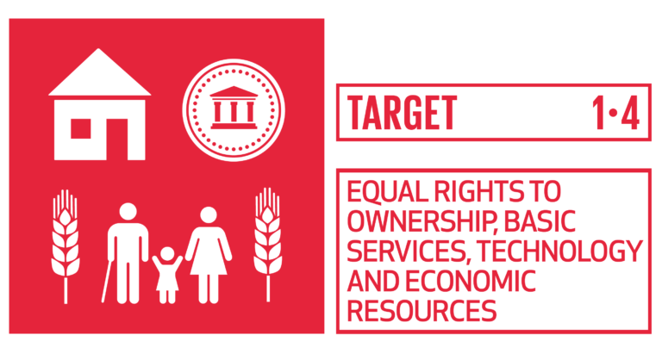
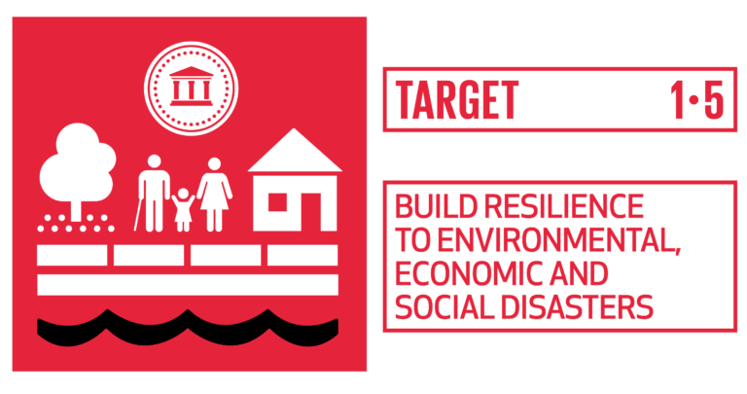
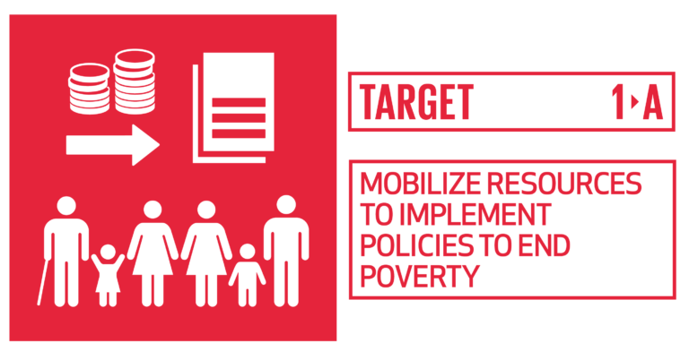
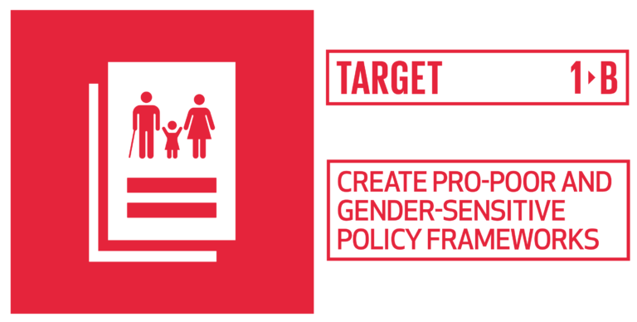
An understanding of the goal No Poverty

Slide 5
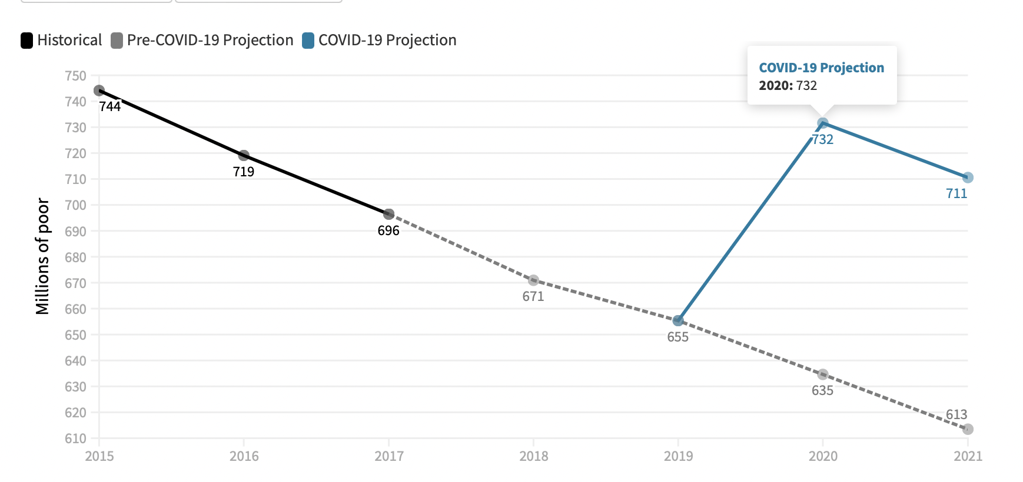
The Problem
Covid-19 reversed the steady progess of poverty reduction over the past 25 years, driving an additional 97 million people in poverty in 2020.
The World Bank stresses that “there is still much we don’t know concerning the impact.”

Slide 6
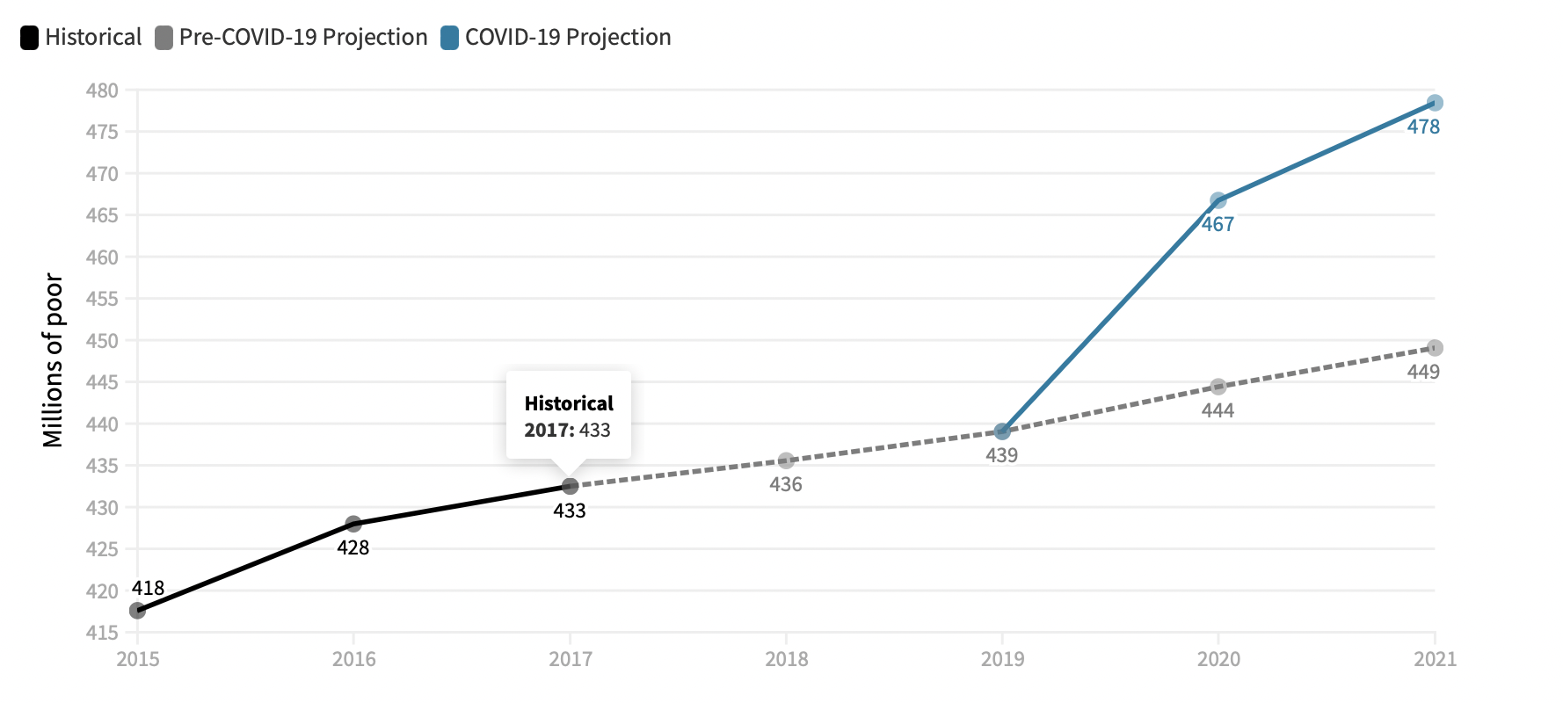
Covid-19 impact on African continents
Covid-19 has worsened the poverty levels for
low-income countries like Africa.
Which were already suffering the most from
Poverty.

Slide 7
Contributing factors to increasing poverty.
People lack access to education through which they can gain knowledge and develop relevant skillsets to improve their livelihoods.
Natural disasters like floods ,storms, draughts have a huge impact on the poor people which takes a toll on their life.
Due to corrupt government officials, money allotted for the improvement of healthcare, education, and welfare institutions does not reach the poor.
Russia’s invasion of Ukraine has caused an unprecedented spark in prices of various commodities, which may further push 40mn. People to extreme poverty.

Slide 8
What can be done
Measures should be taken which bring an immediate impact on this deteriorating situation of poverty.
Countries affected the most with poverty must be identified and impactful actions should be taken.
Countries with highest poverty rates should learn from the policies of the countries with low poverty rates.

Slide 9
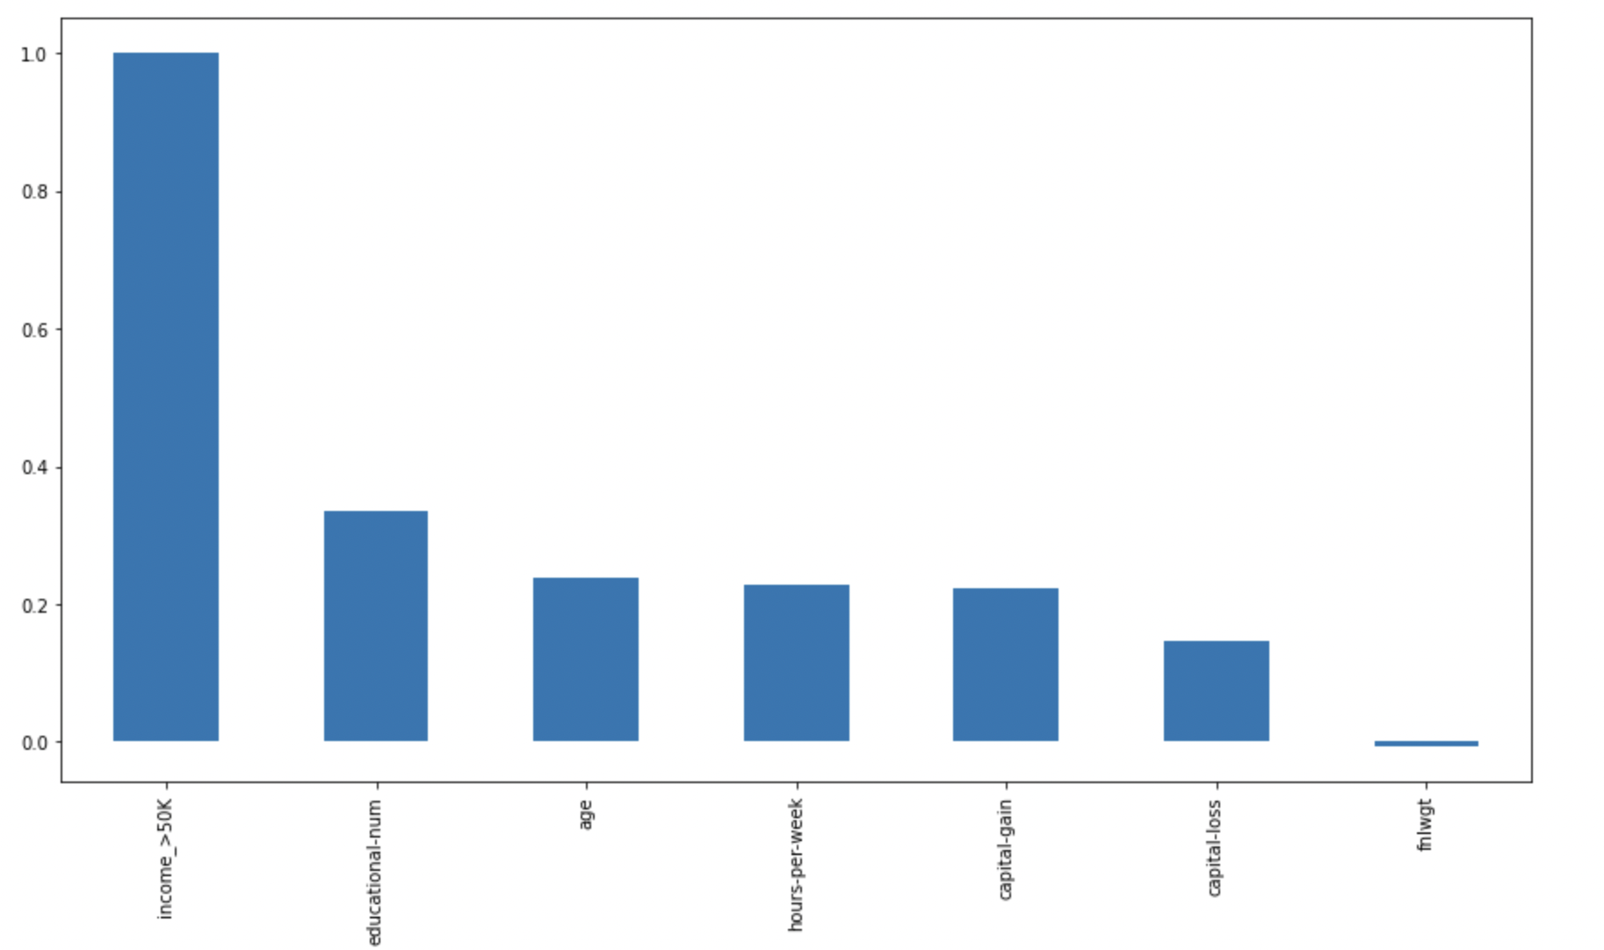
Analysis of Income Data
On performing logistic regression on an income dataset, it was found that education plays a major role in the income of a person.

Slide 10
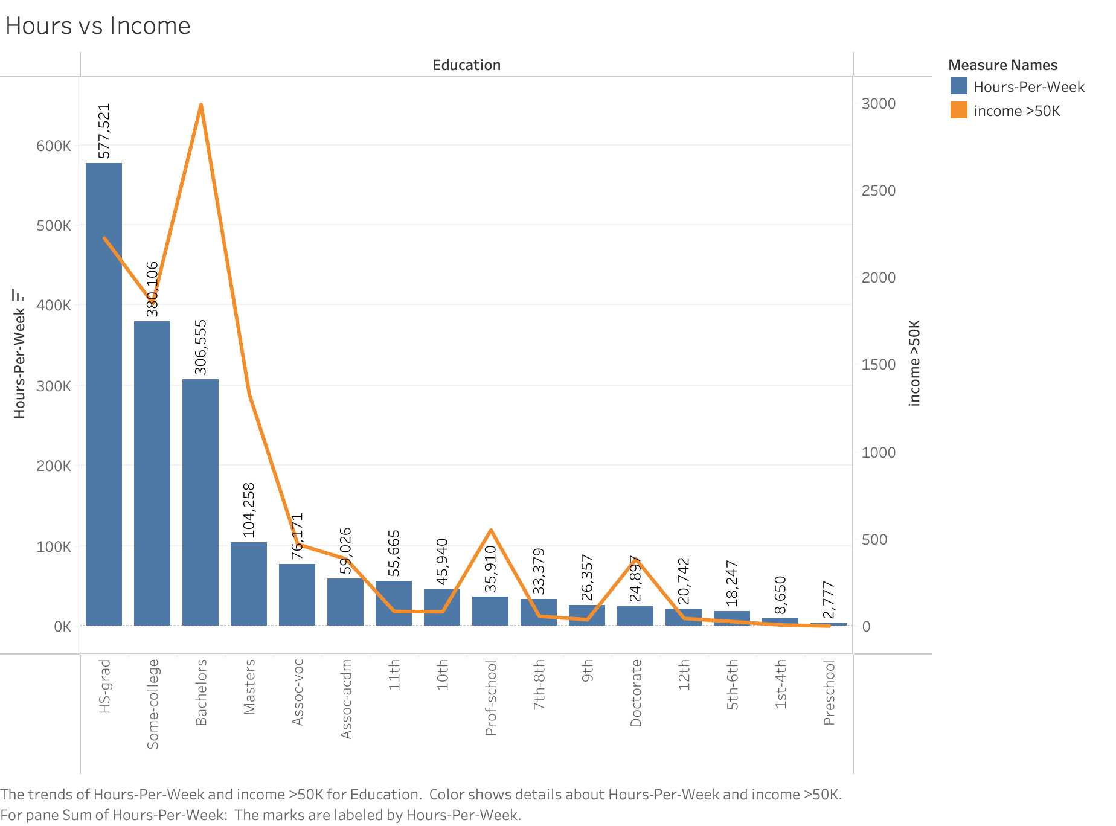
Analysis
In addition, people with higher education earn more than those without education who work longer hours.

Slide 11
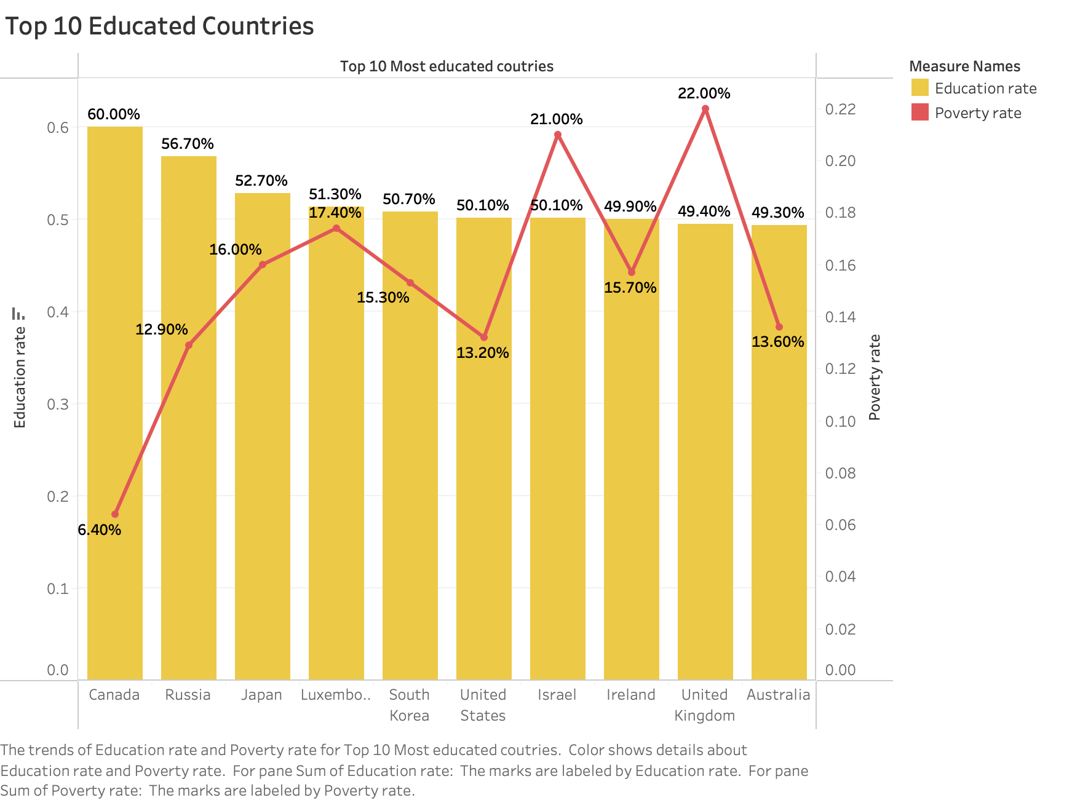
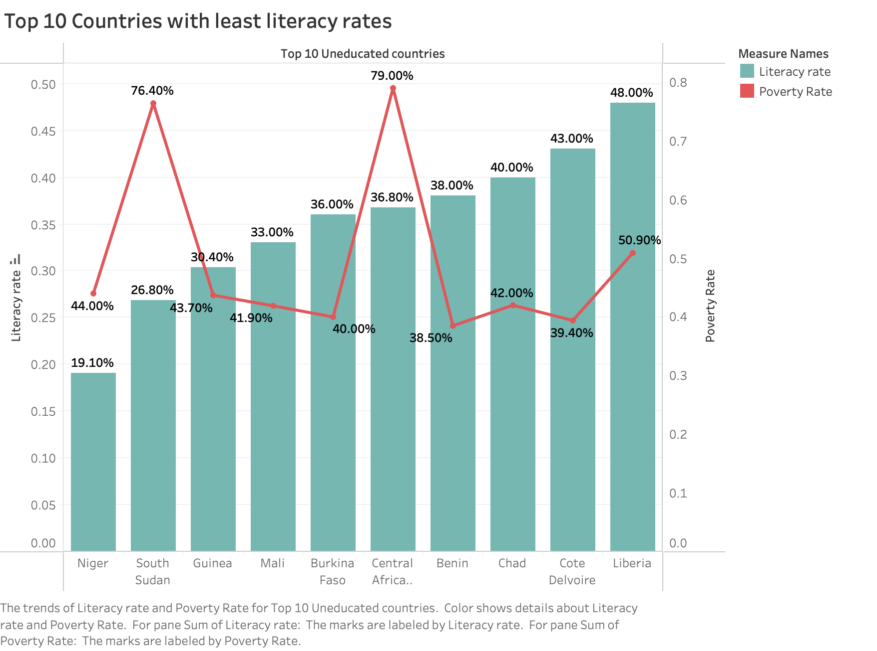
Analysis on Effect of Education on Poverty

Slide 12
What should we learn from these countries
Educated Countries
In some of these countries Education is compulsory.
Some have higher budget on the education system and is regulated by the state
These countries consider education as the nation’s greatest resource.
Least Educated Countries
On the other-hand some of these countries have prolonged violence.
Food insecurity pushes more people into poverty.
No social awareness amongst the people on the benfits of education

Slide 13
What actions can be taken
People should be educated about the benefits of higher education and how it can lift them out of poverty through awareness camps.
The perception of higher education being a luxury for developed countries needs to be changed
Students who wish to pursue higher education should have access to free education, and various scholarships must be introduced to enable this.
We should make people aware of the many free resources that are available for education today and give them access to the internet.

Slide 14
How will this help
Education has a positive correlation with poverty.
Health care, sanitation, and sustainable living will be made more evident through education
People will be more aware about gender inequalities.
We can achieve food security and people will also be aware of the basic food nutrition.

Slide 15
The goal of GENDER EQUALITY will also be impacted
Male
Women

Slide 16
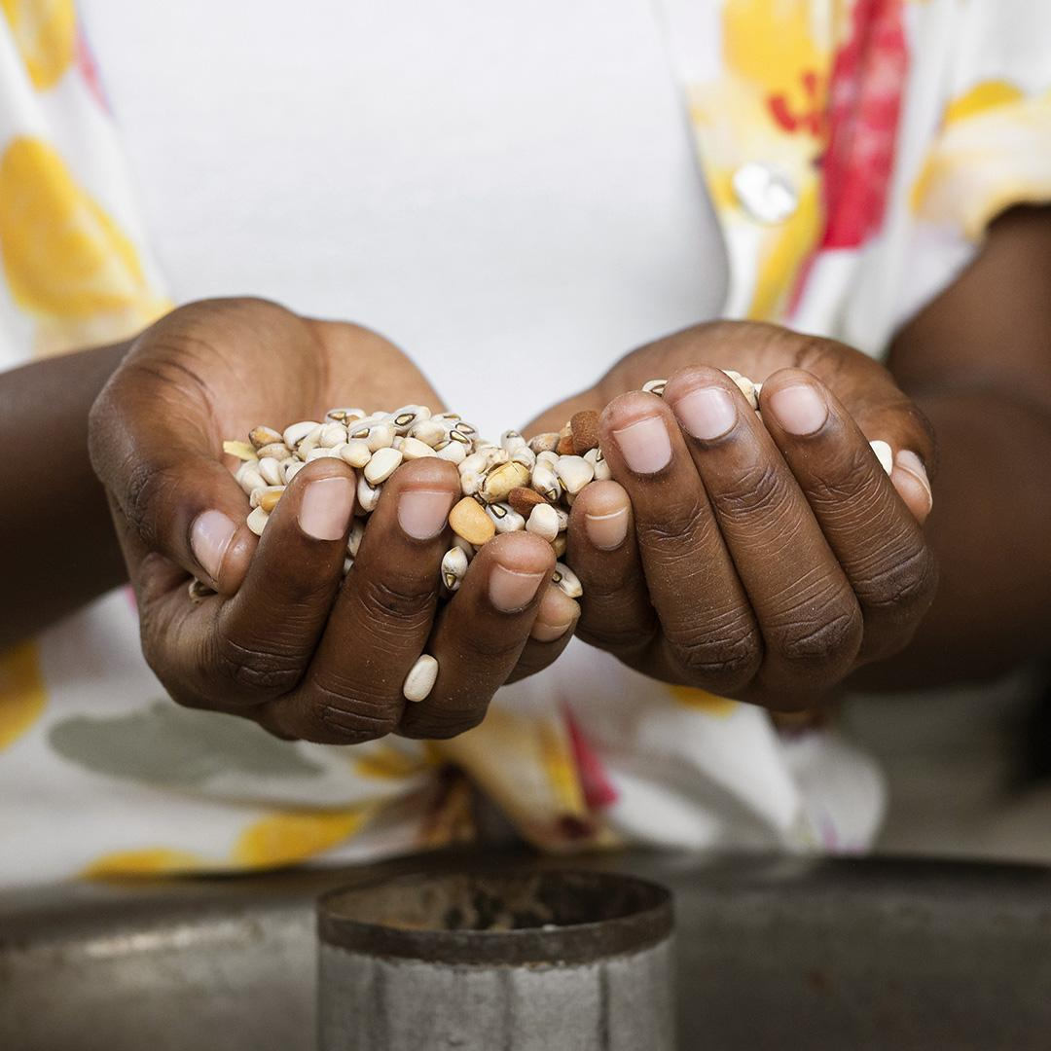
The goal of ZERO HUNGER will have a similar impact
ACHIEVED FOOD SECURITY
IMPROVE NUTRITION
SUSTAINABLE AGRICULTURE
The access to a sufficient, sustainable, and nutritious diet will be made available to people from all walks of life.
People will have access to healthy food and will be able to maintain a balance diet.
In agriculture, farmers would be able to innovate and utilize recycling methods

Slide 17
Conclusion
Educating the youth will have a variety of impacts:
People will start living a healthier lifestyle.
Productivity will be increased which with increased employment, leading to economic growth.
Educated individuals will be able to come together and work against climate change.
Education will lead to reduction in crime rate,reduction in Gender based violence.
Improved mental health.

Slide 18
References.
Antoniades, A., Widiarto, I., & Antonarakis, A. S. (2019, December 28). Financial crises and the attainment of the sdgs: An adjusted multidimensional poverty approach - sustainability science. SpringerLink. Retrieved June 27, 2022, from https://link.springer.com/article/10.1007/s11625-019-00771-z
Updated estimates of the impact of covid-19 on global poverty: Turning the corner on the pandemic in 2021? World Bank Blogs. (n.d.). Retrieved June 27, 2022, from https://blogs.worldbank.org/opendata/updated-estimates-impact-covid-19-global-poverty-turning-corner-pandemic-2021
Addae-Korankye, A. (2014). Causes of poverty in Africa: A review of literature. American International Journal of Social Science, 3(7), 147-153.
Ukwueze, E. R., & Nwosu, E. O. (2014). Does higher education reduce poverty among youths in Nigeria?. Asian Economic and Financial Review, 4(1), 1-19.

Slide 19
Thank You!

